Slide 1

RIDE IT
Capstone Rides Data Analysis
S.Lavanya

Slide 2
INTRODUCTION
RIDE IT is a Multi-service mobility company that offers many types of transport services in one app. Like e-scooters ,e-bikes ,e-vespas ,and car sharing etc..,
This company is working for two different countries
  Germany
  Spain
Taxi and PHV(Private Hire Vehicles) are the two service types that are available.
Few of the drivers include both Taxi & PHV.

Slide 3
OBJECTIVE
This presentation analyses drivers active performance on the RIDE IT platform across metrics, trends, patterns and opt-in behaviour.
Use these insights to propose smart, impactful strategies that boost driver engagement and satisfaction.

Slide 4
RIDER INFORMATION DATA
We have two different datasets about RIDE IT.
  Rideit_drivers
  Rideit_drivers_activity
Rideit_drivers: Driver details are stored.
  Who the drivers are, when did they join, their ratings, if they receive marketing, gold rating, type of service.
Rideit_drivers_activity: Details about drivers activity.
  Daily ride offers, accepted rides, completed rides and cancellations.

Slide 5
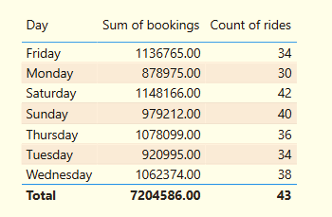
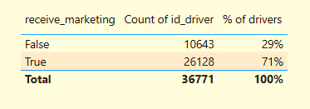
BUSINESS OVERVIEW
Total drivers are 36.77K with total of 5.90M Rides.
Drivers who are working under TAXI: 31321(85%), PHV: 5651(15%) and Both: 201 members only.
71% of drivers opted to receive marketing notifications.
Peak activity rides on Friday-Saturday.

Slide 6
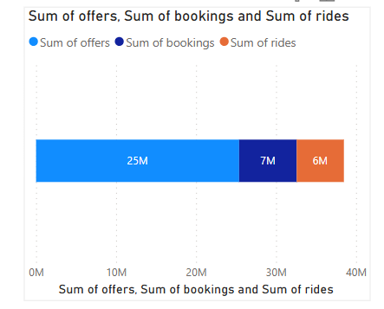
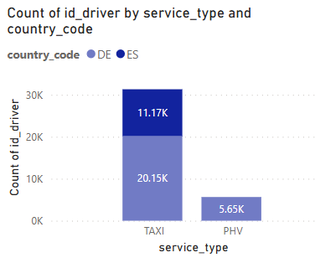
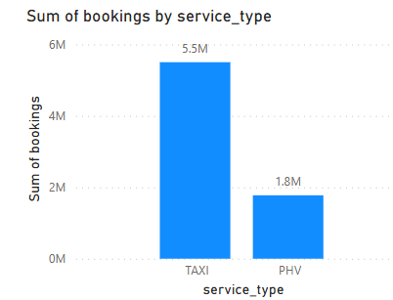
25M total offers generated 7.20M bookings at 28.4% conversion rate.
Germany having more drivers(25.6K) than Spain(11.17K).
Drivers of Spain chose only TAXI and Drivers of Germany chose both TAXI & PHV.
TAXI service leads bookings (5.5M) over
PHV(1.8M)

Slide 7
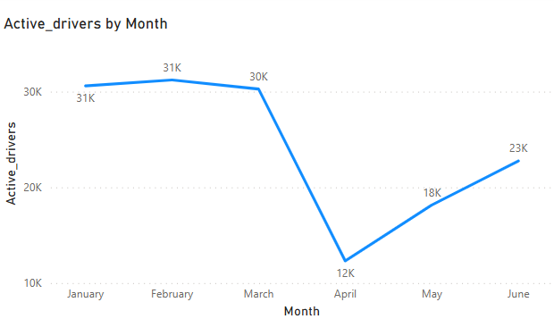
MONTHLY TRENDS
Drivers activity peaked in February (31K) then suddenly decreased to (12K) in April.
Again, Recovered from the month of May(18K to 23K in June).

Slide 8
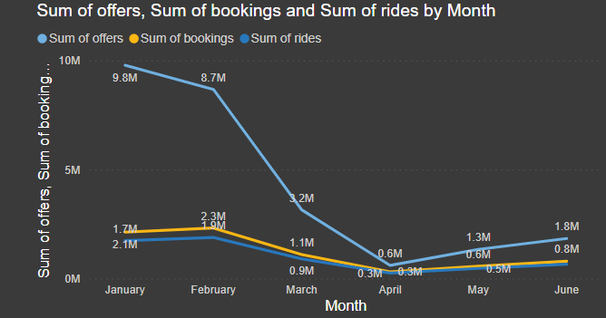
OFFERS,BOOKINGS and RIDES
The number of offers is high in January compared to other months.
Offers, Bookings and Rides shows similar pattern with March-April.
Highest Bookings and Rides
are done in the month of
February(2.3M & 1.9M) and
lowest in April(0.3M both).
Reasons: Holidays, Weather,
Price hikes.

Slide 9
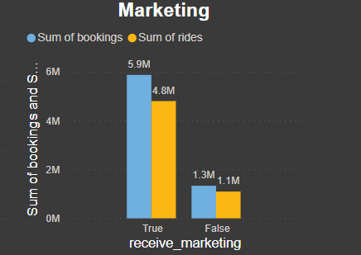
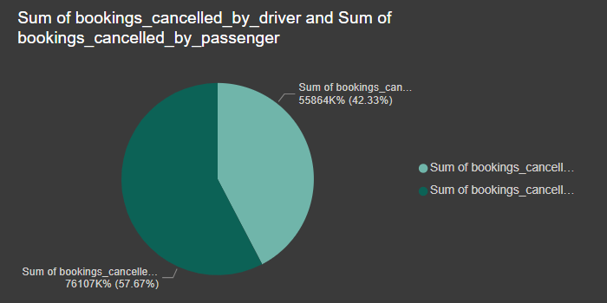
MARKETING:
Marketing is a add on feature to boost the offers
to the Drivers.
Drivers who opted for marketing received more
offers resulting in completing high No. of rides.
Marketing could be helping the top-performing
drivers stay active and reach goals.
CANCELLATION:
Total number of bookings cancelled by Drivers
(42.33%) and bookings cancelled by Passengers
(57.67%).
The Passenger cancellation rate is higher than
the Driver’s.

Slide 10
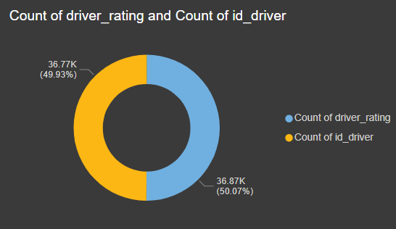
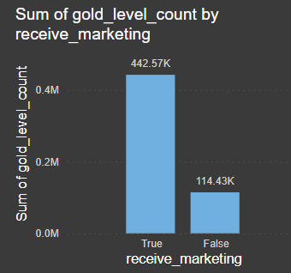
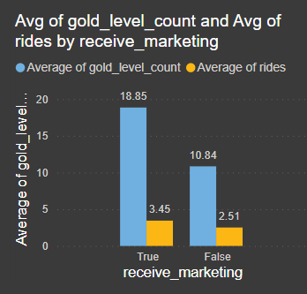
RATING, GOLD-LEVEL Drivers and Marketing Opt-in
Drivers who chose Marketing Opt-in reached Gold-level more often(442.57K Vs 114.43K).
If a driver reached Gold-level 16 times on an Average, they are considered to be top performers in a specific week.
Balanced rating distribution.
On an Average, 4.8 rating is given to the Drivers.

Slide 11
REASONS FOR DECLINE IN OFFERS and BOOKINGS:
Covid is the main reason for less number of drivers active after March.
Less number of drivers and customers contributed less offers and less bookings.
RECOMMENDATIONS:
Encourage the drivers to opt for marketing to receive more offers.
Designing the price models based on the demand.
Make sure there is no technical issue causing a problem for riders to accept the offers.
Recognize and privilege high-rated, active drivers.
Provide extra benefits to drivers who consistently work weekends and occasional days.
Implement stricter cancellation policies.

Slide 12
THANK YOU

